Slide 1

Test Plan Presentation
Team 1: Gamification of Data
By: Zaid Alsafi, Alex Navarre, Cameron Kozan

Slide 2
Software Scope
The goal of this project is to develop a gamified web application. The gamified web application will allow for the workers to be more motivated along with increasing productivity. The end goal of this project is for a user to go into the web application see how they rank among their peers, look at achievements, along with how all their teams are doing as well.

Slide 3
Pages To Be Tested
Login
Dashboard: Admin & Employee
View Profile
Manage Team
Team Detail
Manage Employee
Employee Detail
Manage Assets
Edit Assets

Slide 4
Test Strategies
Unit Testing
Integration Testing
Validation Testing
High-Order Testing

Slide 5

Unit Testing
Unit Testing
Our team will be unit testing each component individually. We will be using both black and white box testing methodology. Each component will be tested by grabbing data from the database and we will be checking the output. We will be doing this to find any bugs that the unit of code will have.

Slide 6

Integration Testing
Each member will be performing testing the individual component before the unit is integrated. When all team members agree that an individual component can be integrated that code will be sent to the main branch on github. When the integration is completed two members will go through a checklist and see if anything unexpectedly changed it will be logged and what severity the bug will be. If the severity is extremely high both members will try to find the issue and fix the problem before integrating any unit.

Slide 7

Validation Testing
For validation testing, we will be testing with the client on live servers to ensure the website matches the clients requirements. We will go through every feature with them to make sure it meets their expectations. Black box testing will be used for our validation testing with our customers.
The database is hosted on AWS RDS and the front and backend programs are hosted on AWS EC2 instances.

Slide 8
High-Order Testing
For high-order testing we will be using different test methods to test the various conditions:
Stress Testing
We will be testing at various frequencies with randomly generated data inputs, in large sums, to validate the braking point of each individual interface.
Performance Testing
We will be testing the range of performance to gauge the softwares compatibility and functionality. We will be mainly testing the Manage Asset page to judge the loading time of all the assets from the database. This will let us confirm that the minimum loading times are within the customer specifications.
Security Testing
We will be using SQL injection testing and password salting to judge the level of security being provided.

Slide 9
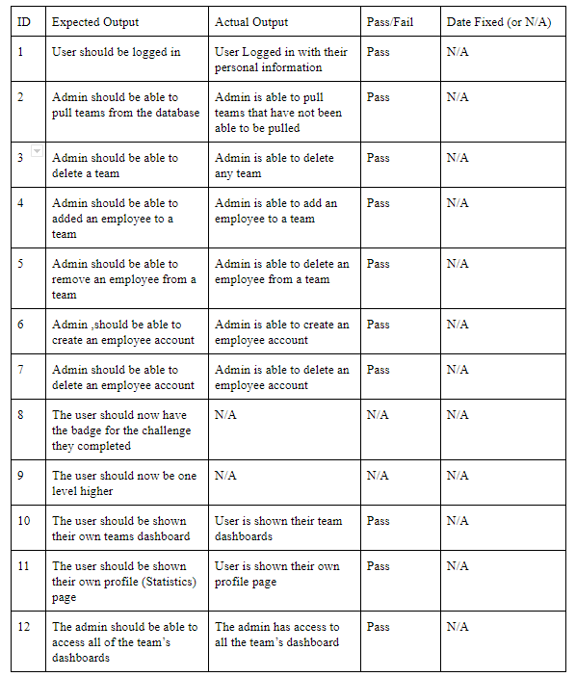
Test Cases
Here are just a few of our many test cases for this project.
When Actual Output = N/A means that it hasn’t been implemented or hasn’t been tested yet.

